Slide 4
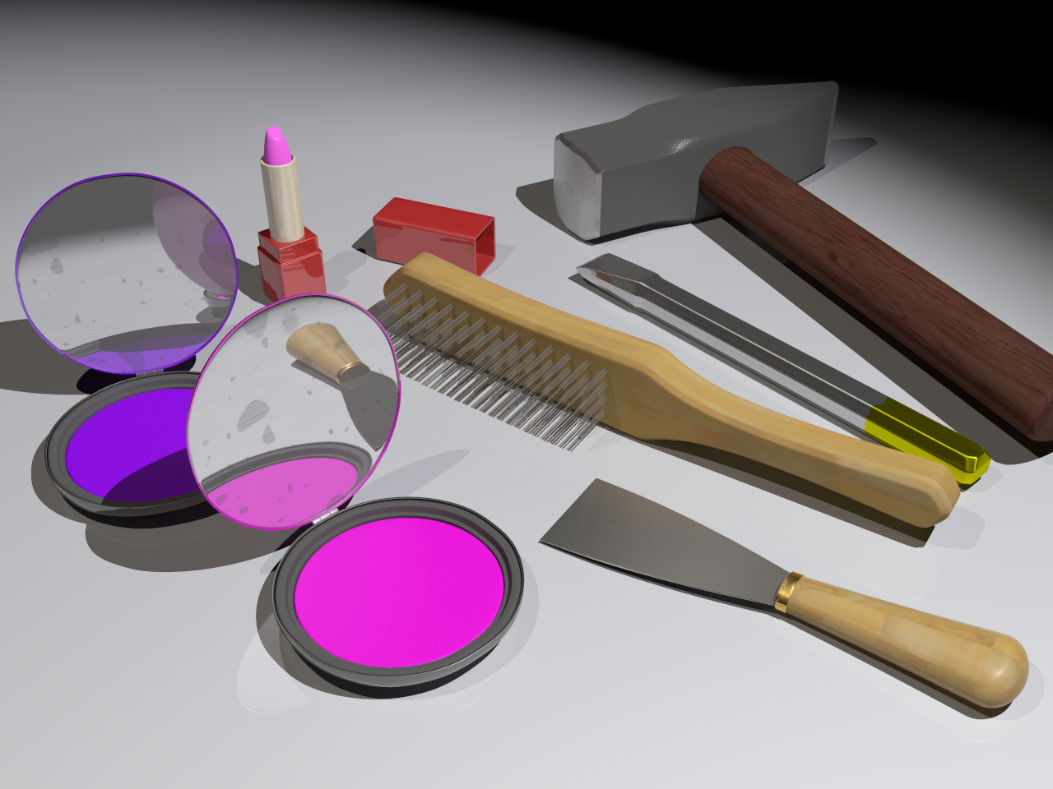
How I got Here
Notes:
Well via going walk about and avoiding university.
The rest as they say is history.
The story of Morticia – my first Work Experience.

Slide 5
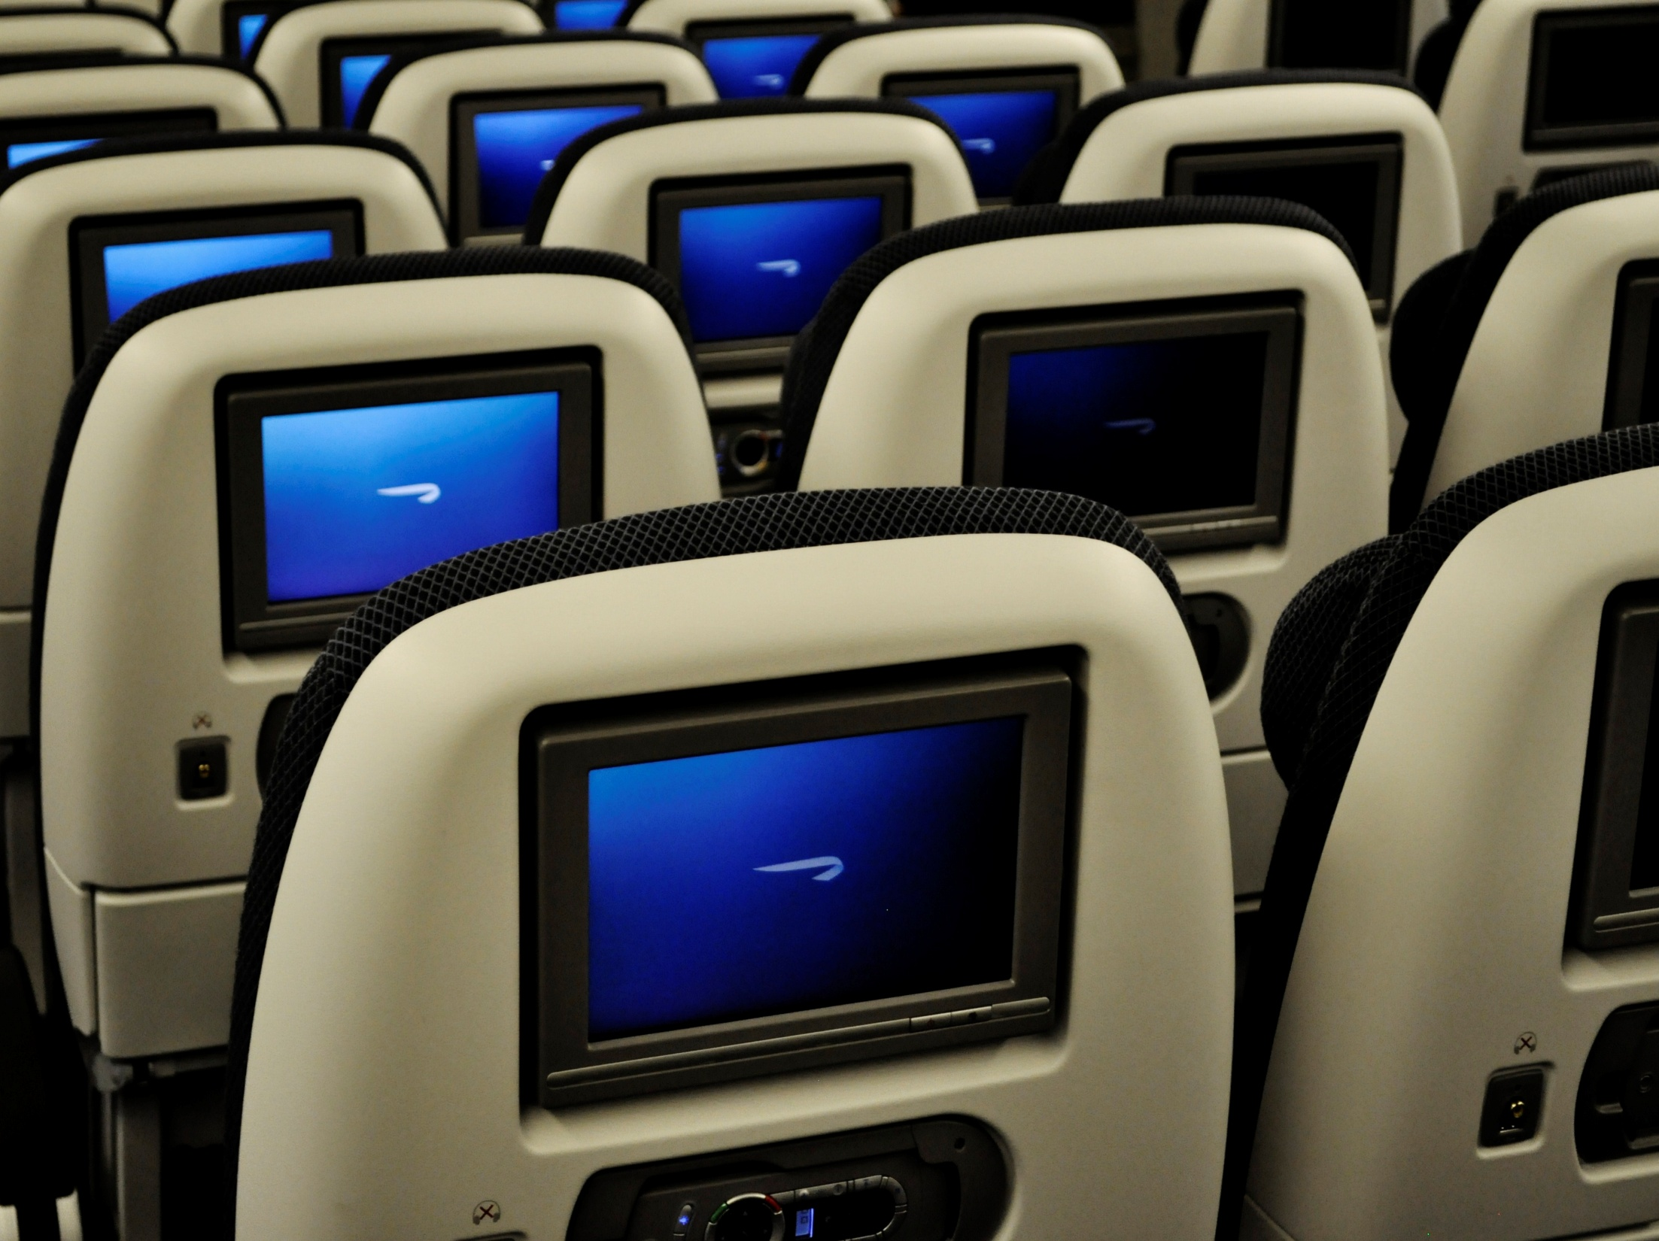
High Miles
Notes:
The Walkabout continued with Work
I love my Jobs. They take me places.
Literally!
The story of airbus

Slide 6
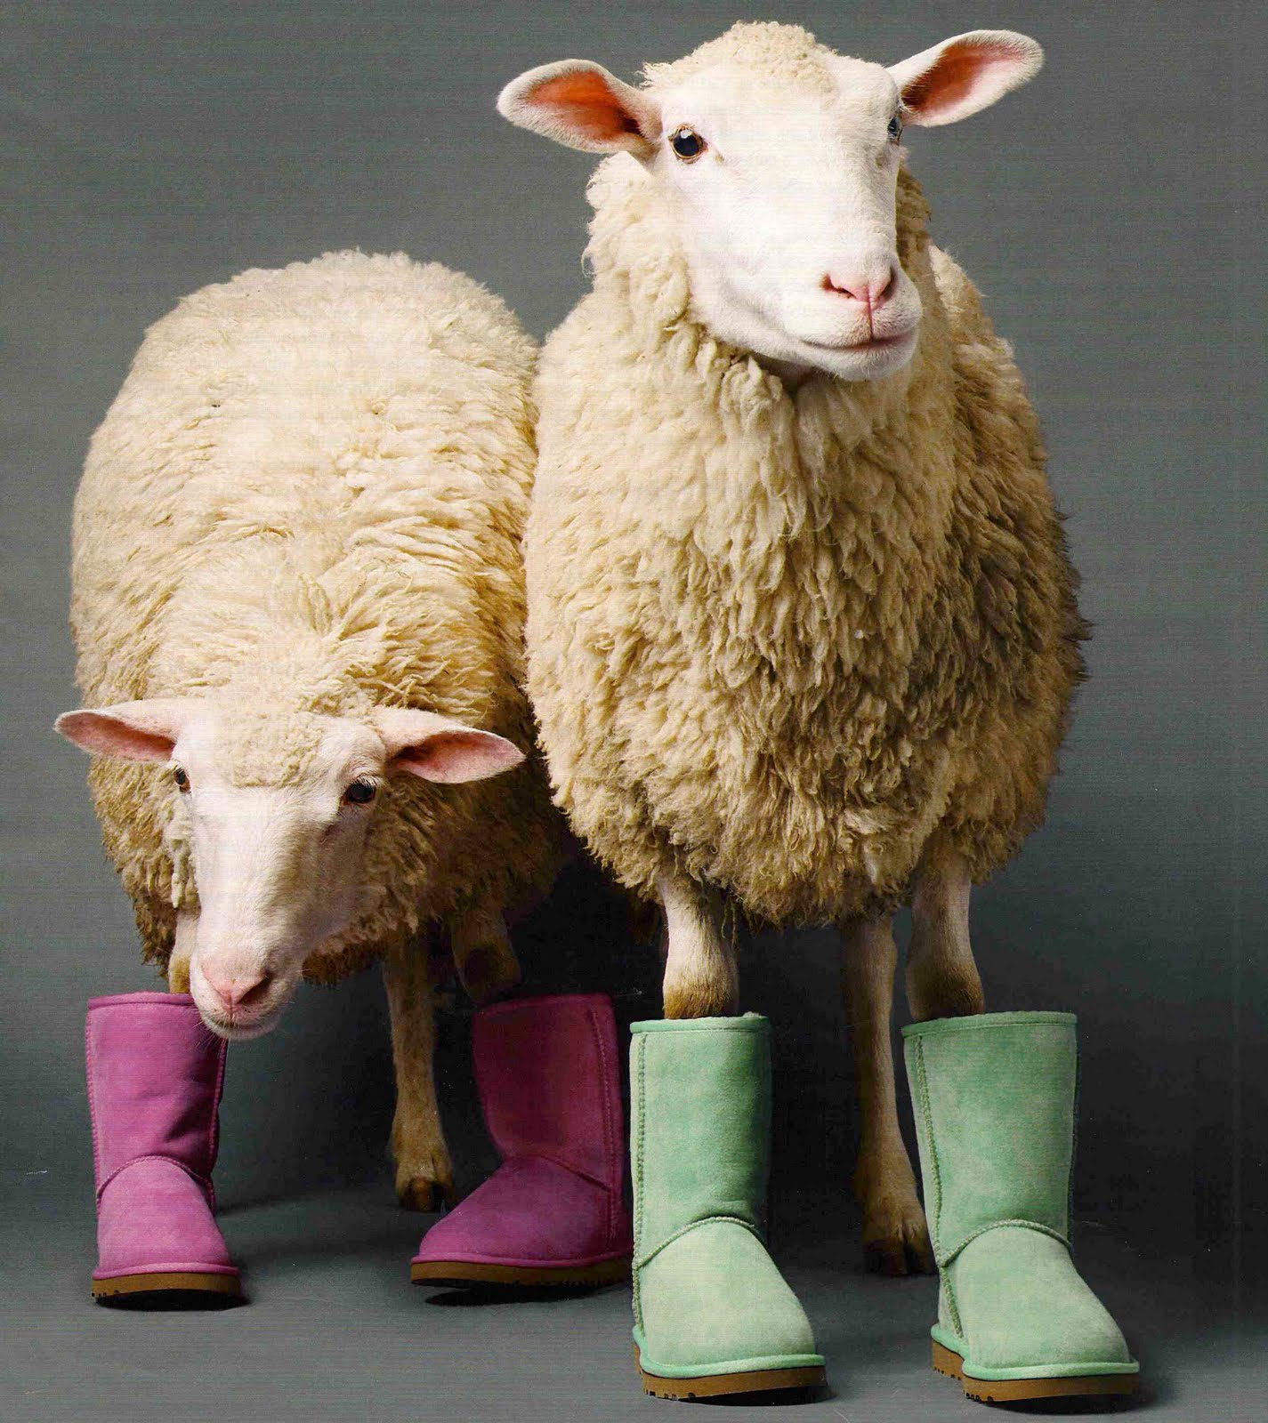
Low Metres
*6
Notes:
My biggest walkabout happened right from home
And I learnt the lesson of sheep and mute.
The stories of PRA and Unilever People
Lessons learned☺
Rapport is everything. Smile down the phone – people will know you are.
Talk about the weather. It’s a two for one – listen to the words and you can guage what level to pitch your language at and how good the line quality is.
Never be afraid to hang up the phone, until you get a good enough line to talk.
Without good sound you are both lost.
Know that some countries really have crap landlines.
Know that sometimes people will call you from the strangest places – *6 on most conference services is mute!
Find a pen pal. You’ll find out loads about them, their people and their country.
Mine had a talent for reminding me I live in the UK and they live somewhere warm, hot and inevitably sunny.
The other couldn’t get cricket. It was absolute futility and the best of fun!

Slide 7
What’s Blocked ?
Notes:
The story of how projects go at your house
Reflect how that matches reality (use the vicous cycle circle to guide this part)
It’s taken me a long time to realise that the rate that I create work = the rate that I must clean up and put away!, because in order to exploit all available constraint hours
(worth noting – does the kids, clothes, washing, mowing, cleaning, swimming, shopping, gadget support, tv entertainment recording, enforcement etc….☺)
(because I would have to be able to afford to pay a mastercraftsman to replace him)
I have very little time – so I must waste any of it. And all though I don’t want to train him into a bad habit; it is one that for now is the best habit for the both of us – that way it is win win.
So that’s the First Step of Constraint Management – Identify where flow is stopping you doing more of your goal. In my case the goal is to have a Home and Beautiful House.
My Poor Bloody Husband.
I do not advocate this as marriage advice BTW☺
Now as this is being recorded, and talking more on this line of thought is likely to get me shot, it is time to shift gears..high gear into forumlae one.

Slide 8
Current Flows
IESEI
Notes:
Tell a story of mclaren
the familiar environment created by the FIA – from money to budgets, the timescales races, the tests
So it’s a little different too.
One thing all environments have in common - murphys’
In fact let me introduce Finagles.
Larry Niven, Mathmetician, Scientist and creator of the Discworld Novels developed the following formulae to express how and when and what happens when uncertainty and unpredictability collide.
Let me introduct Finagles Law. Expanded to now include a few others of course too;
Chuckle – recognise these☺

Slide 9
IDENTIFY
EXPLOIT
SUBORDINATE
EVLEVATE
INERTIA (AVOID IT)

Slide 10
Making Stuff Happen
IESEI
CCPM
Notes:
A Story of Uncertainty
Project Management 101. Don’t. ☺
Like overcoming adversity? The best forumulae to acknowledge is:
My dad hit a kangaroo once. It’s the one time of been certain of anything. I knew when I’d seen it that three pieces of kangaroo hurtling off the bonnet of the car at 220km’s per hour didn’t equal an alive kangaroo.
Now my driving experience is different. Well I don’t hit kangaroos over here. I have reversed into a very important collectible car at a formula one team. Pause. But’s that’s another story.
I drive too fast. I’m always going faster in order to get more things done. One day I got caught doing 103mph on the M54. Quick thinking and instant rapport building led me to drive away. And to keep my liscence. And to learn a lesson (after I changed trousers☺) on how to get more by doing less.
Remember the first step…identify the constraint. What is it? Management Attention. More precisely Me. I was running so hard that I didnh’t have any time for good decision making.
I’m tired. Good night! Well done you this presentation is looking fine so far. You know where it is going to because you have the end.

Slide 11
CRITICAL CHAIN
BUFFER MANAGEMENT

Slide 12
Chain Reaction
IESEI
CCPM
9 LAYERS
Notes:
Right – so many tools here to use.
Here is where I find that I use the same techniques and tools every day; in a different and unique way because it is working with people.
Reflect on the triangle with language of leadership
Laugh and stop – must move on their – unless alan you want to presnet something from my pack…
Tell the story of the carpark
Acknowledge the process. If it is easy say so. If it is hard or unfamiliar then declare it.
Name it
Explain the steps.
Check that permission is granted and what is going to be shared or not shared afterwards.
And then work through the layers of resistance.
It requires to think on your feet – don’t be an expert. Admit confusion when it exists.
Get into Inquiry.
Remember that they could be virgins at this too. Ease off if they cry ☺
Move into collaboration.
It really gets you places – and when energy is focussed in the same direction – get ready for the chain reaction! (I am reminded of chain reaction by …Shirley, Dione, some lovely black lady!☺

Slide 13
9 LAYERS OF RESISTANCE

Slide 14
EVOLVING AN ORGANISATION
MINDSCAPE

Slide 15
MINDSCAPE

Slide 16
Notes:
The formulae
constraint symbol then
Weaving rope symbol, then
Balancing Eyes symbol, then
Fade to Black.
Video.

Slide 17
PLACEHOLDER FOR FOOT NEAR CAR PHOTO
Notes:
OOPS!

Slide 18
Coalesing Ltd
w: www.coalesing.co.uk
e: rachael@coalesing.co.uk
t: 033 0220 9995
@rachaellear
Rachael Lear
rachaellear1

